Slide 1
Prediction of Woman’s Legal equality across countries
-women warriors
(Sushmitha C S
Nadhira K C)

Slide 2
Introduction
When societies achieve gender equality, economies become more resilient.
Women, Business and the Law (WBL) is an association within World Bank Group collecting data on the laws and regulations that affect women's economic opportunity.
It identifies where and which laws and regulations restrict women’s economic inclusion, providing an important resource for achieving their full and equal participation.

Slide 3
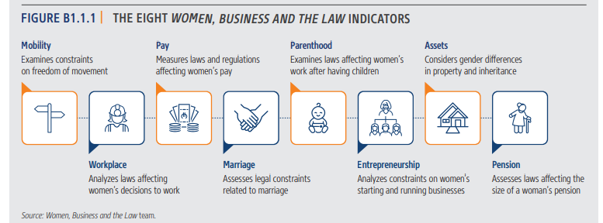
The eight women, business and the law indicators The eight Women, Business and the Law indicators coincide with the milestones that many women experience throughout their adult lives.

Slide 4
WBL Index
In total, 35 questions are scored across the eight indicators(Mentioned in previous slide) as part of the survey.
Overall scores are then calculated by taking the average of each indicator, with 100 representing the highest possible score which provides the WBL index.
WBL index= AVG(workspace,pay,parenthood,mobility,entrpreneurship,
assets,pension,marriage).

Slide 5
Objective
Prediction of Legal equality and women’s economic empowerment based on WBL index for a given country/economy.
Economy | Report Year | MOBILITY | WORKPLACE | PAY | MARRIAGE | PARENTHOOD | ENTREPRENEURSHIP | ASSETS | PENSION | WBL INDEX
Afghanistan | 2022 | 50 | 75 | 0 | 20 | 20 | 75 | 40 | 25 | 38.1
Albania | 2022 | 100 | 100 | 100 | 100 | 80 | 100 | 100 | 50 | 91.3
Algeria | 2022 | 75 | 75 | 50 | 60 | 60 | 75 | 40 | 25 | 57.5
Angola | 2022 | 100 | 100 | 50 | 100 | 60 | 100 | 100 | 25 | 79.4
Antigua and Barbuda | 2022 | 75 | 50 | 75 | 100 | 0 | 75 | 80 | 75 | 66.3
Argentina | 2022 | 100 | 75 | 50 | 100 | 60 | 75 | 100 | 75 | 79.4
Armenia | 2022 | 100 | 50 | 75 | 100 | 100 | 75 | 100 | 100 | 87.5
Australia | 2022 | 100 | 100 | 100 | 100 | 100 | 100 | 100 | 75 | 96.9
Austria | 2022 | 100 | 100 | 100 | 100 | 100 | 100 | 100 | 75 | 96.9
Azerbaijan | 2022 | 100 | 100 | 0 | 100 | 80 | 100 | 100 | 50 | 78.8
Bahamas, The | 2022 | 100 | 100 | 75 | 80 | 20 | 75 | 100 | 100 | 81.3
Bahrain | 2022 | 50 | 75 | 100 | 40 | 40 | 100 | 40 | 75 | 65
Bangladesh | 2022 | 100 | 50 | 25 | 60 | 20 | 75 | 40 | 25 | 49.4

Slide 6
Continued..
The above is a sample of dataset for the year 2022,As seen the WBL index is still low across the countries , Our goal is to use the data available(refer next slide for dataset) and predict when a particular economy is going to give Legal equality economic empowerment to women.
Provide analysis based on the current statistics.
Find the indicators to be improved if the economy cannot reach the goal by 2050.
Factors such as education, cultural and social norms are not included, hence the prediction is also limited to the same factors available.

Slide 7
DataSet-WBL
It contains information from 1971 to 2022.

Slide 8
References
https://wbl.worldbank.org/content/dam/sites/wbl/documents/2021/02/WBL2022Chapter1.pdf

Slide 9
DEMO

Slide 10


Features FAQs
Ever wondered how legally gender equality exists across economies and how they impact on women empowerment ?
Legal Equality Prediction model will help identify the same.
Click the below button to predict your country’s current stat and when it will reach its legal equality
Click below to learn more
START PREDICTION
LEARN MORE

Slide 11








Features FAQs
Our Model predicts Legal equality across countries based on the below factors
MOBILITY
ENTREPRENEURSHIP
To examine constraints on freedom of movement
To analyze constraints on women’s starting and running business
WORKPLACE
PARENTHOOD
To analyze laws affecting women’s decisions to work
To examine women’s work after having children
PAY
PENSION
To measure regulations affecting women’s pay
To assess laws affecting the size of women’s pension
MARRIAGE
ASSETS
To assess legal constraints related to marriage
To consider gender differences in property and inheritance
Back to Home Page

Slide 12
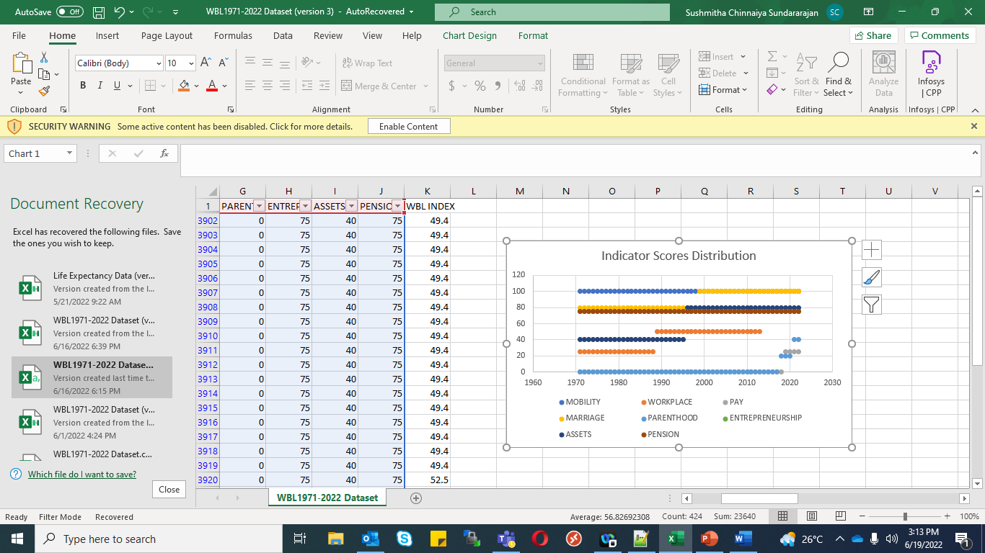
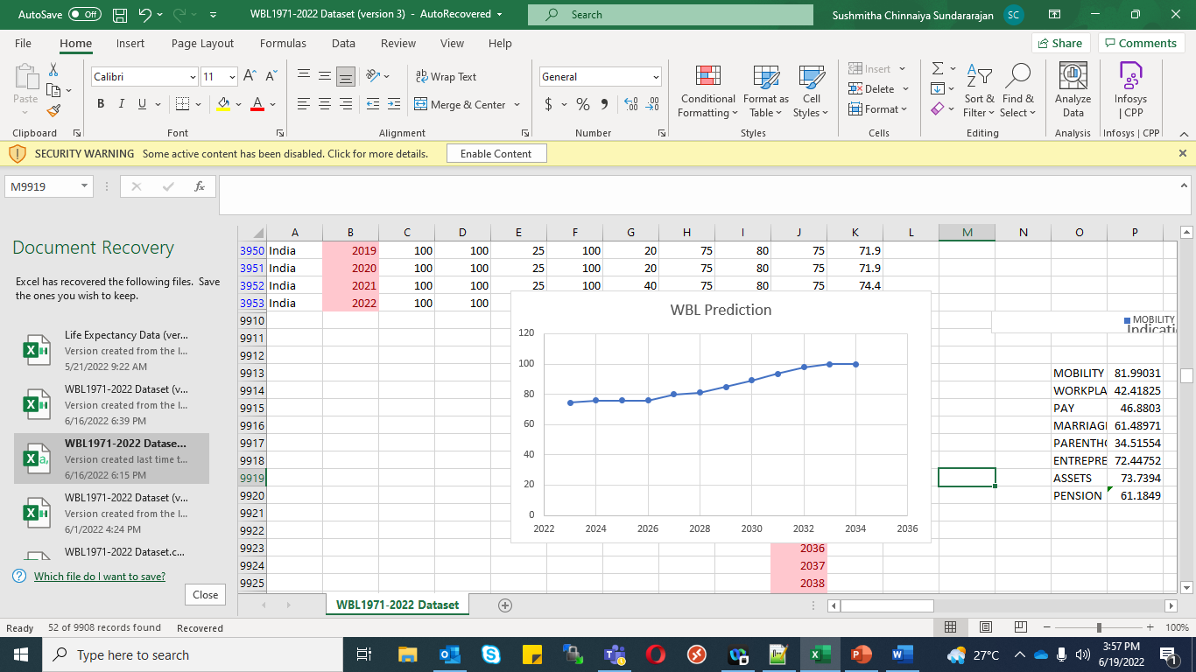
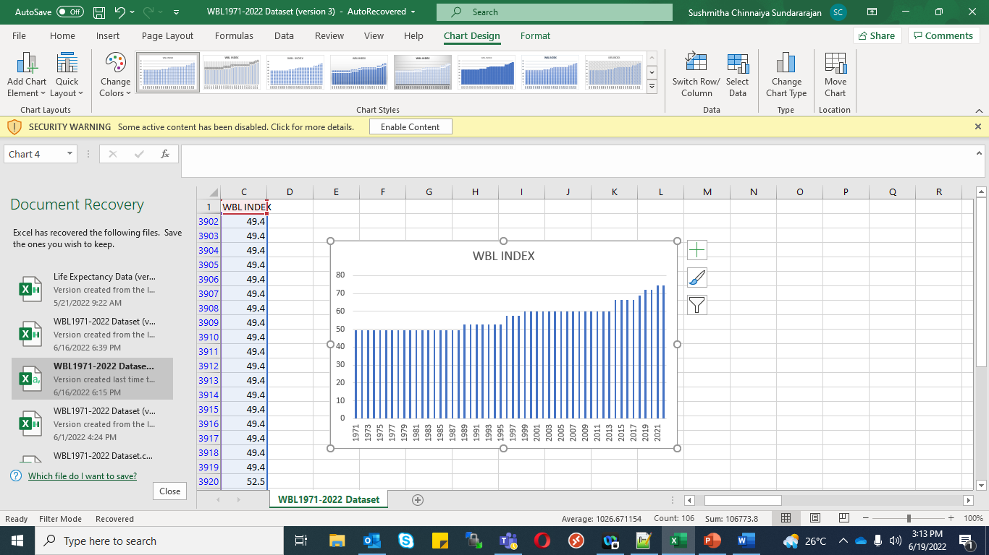
Features FAQs
Prediction of Legal equality and women’s economic empowerment across countries
COUNTRY
India
Current Stats
Prediction
Congratulations! Our model predicts that India will reach 100% by 2034

Slide 13
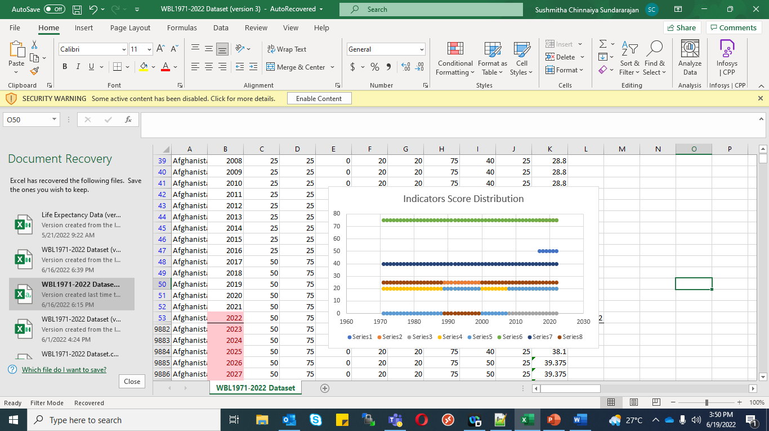
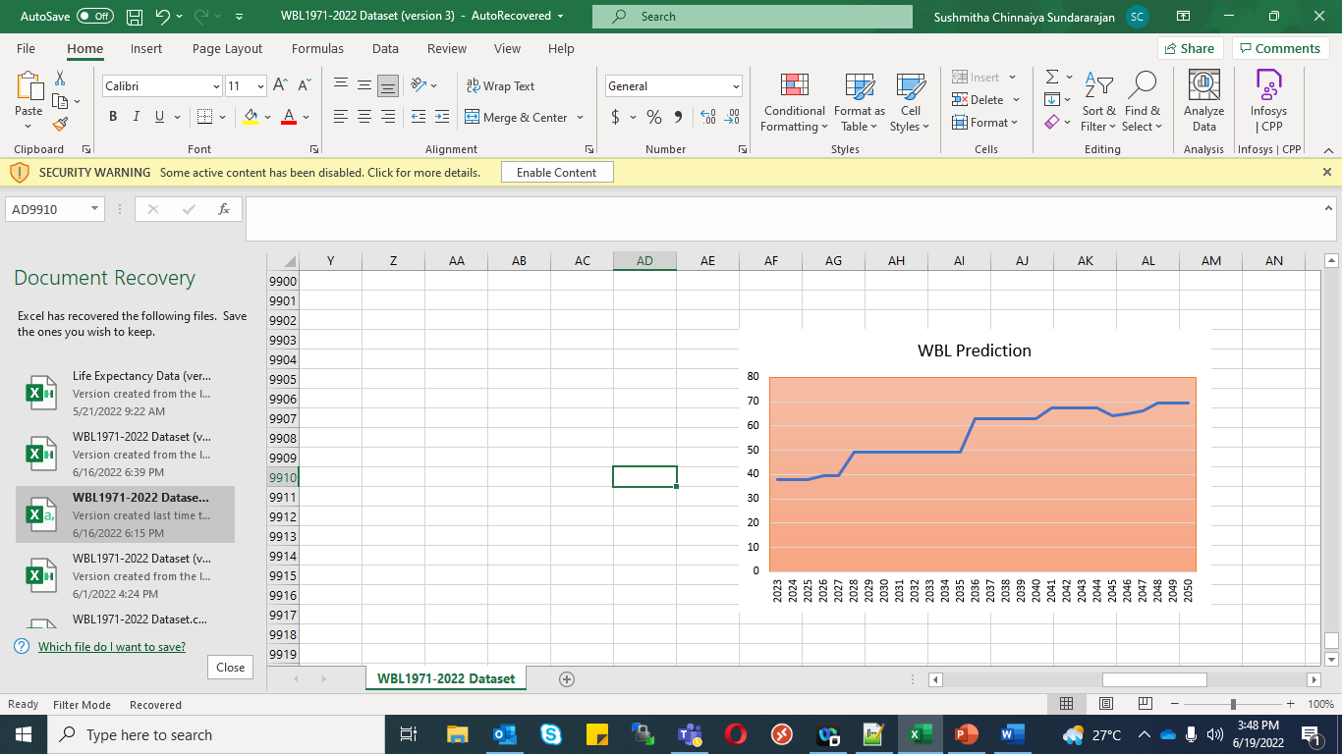
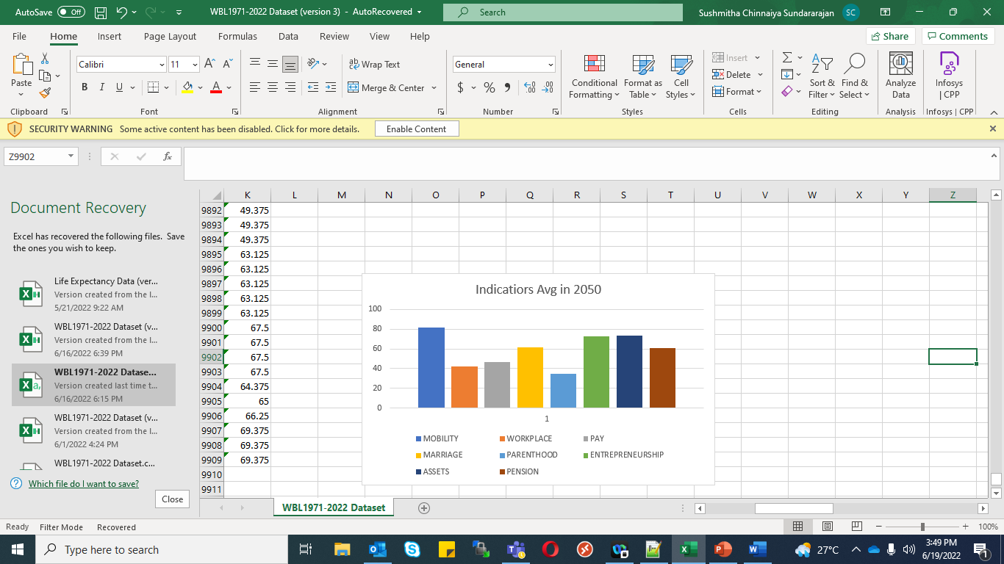
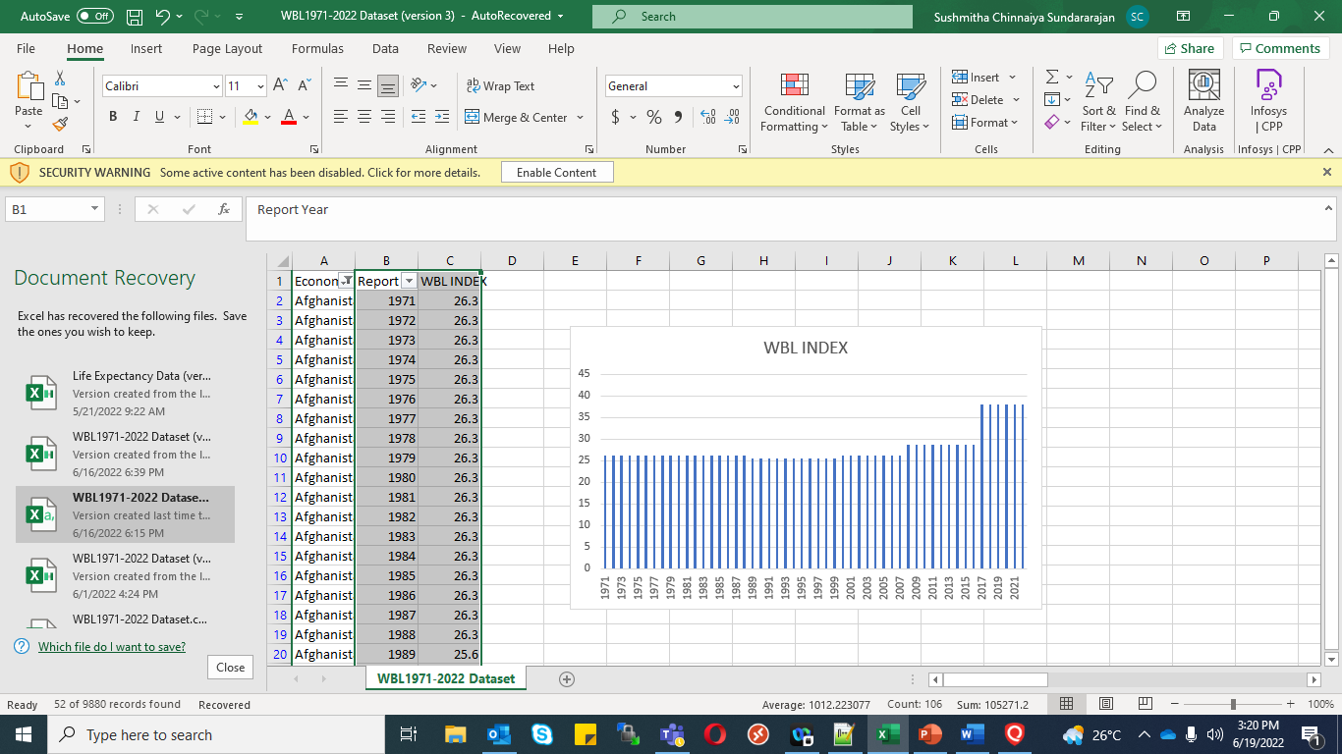
Features FAQs
Prediction of Legal equality and women’s economic empowerment across countries
COUNTRY
Afghanistan
Current Stats
Prediction
Our model predicts that Afghanistan will not reach Legal equality by 2050. Laws related to parenthood, pay, workplace needs to be strengthened for the economy to reach gender equality on a legal basis.

Slide 14
Tech Stack:
Azure ML
Python
Angular8
Azure container & computational resources.

Slide 15
Source code
https://infygithub.ad.infosys.com/sushmitha-s12/AzureHackathon

